Slide 1

Data Cleaning
WQD7001

Slide 2
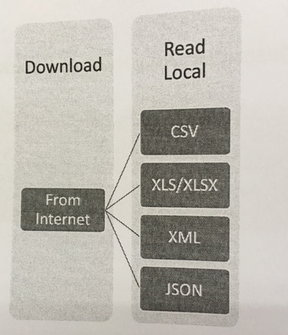
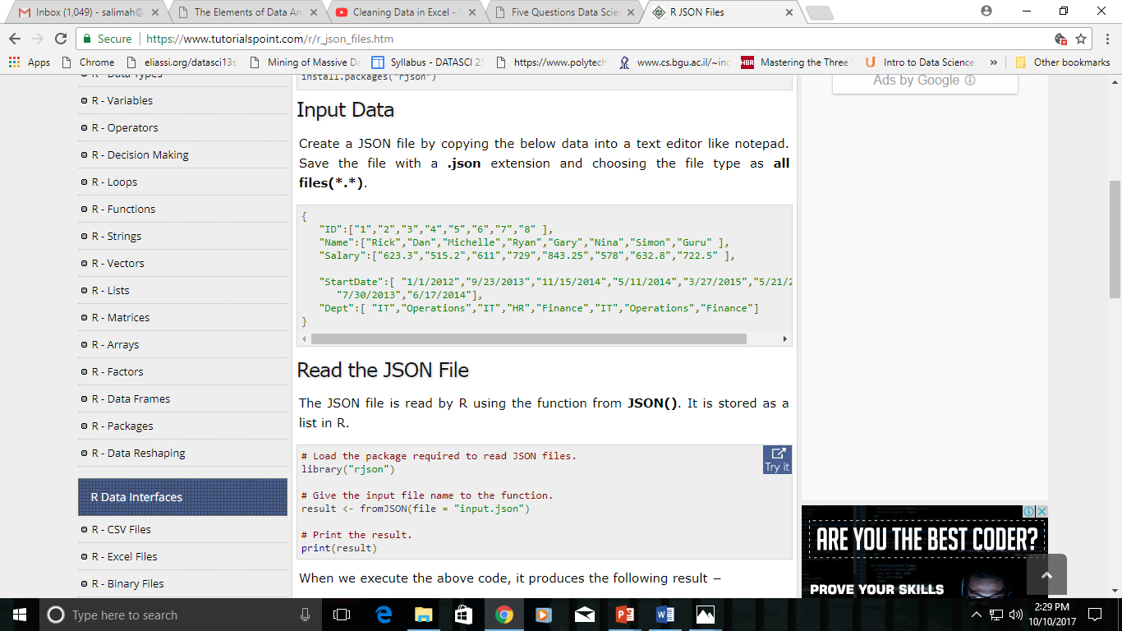
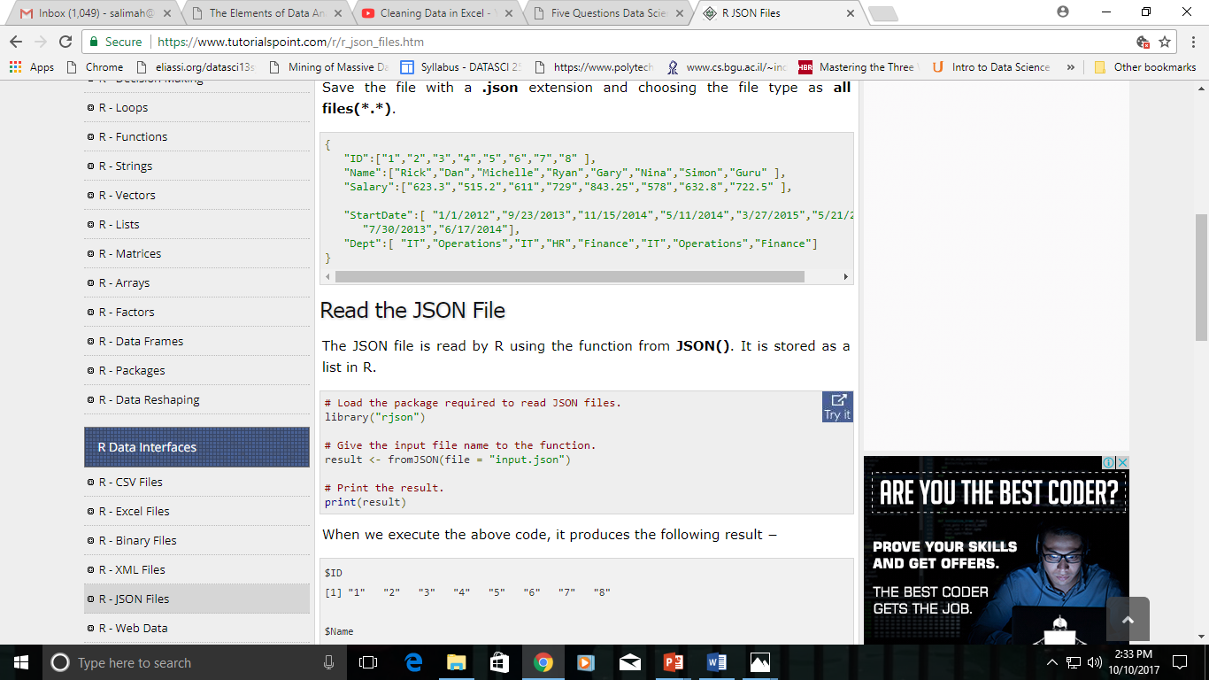
What You Have Done
JSON file stores data as text in human-readable format.
Json stands for JavaScript Object Notation.
R can read JSON files using the rjson package.
install.packages("rjson")
Create a JSON file by copying the below data into a text editor like notepad. Save the file with a .json extension and choosing the file type as all files(*.*).
Read the JSON File
The JSON file is read by R using the function from JSON(). It is stored as a list in R.
download.file() to download a file from the Internet.
read.table reads all data into RAM
https://www.tutorialspoint.com/r/r_json_files.htm

Slide 3
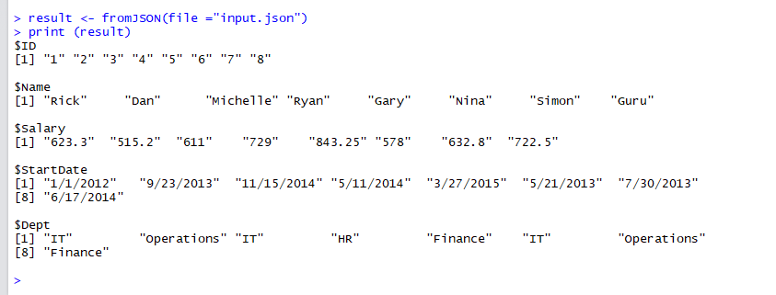

Slide 4
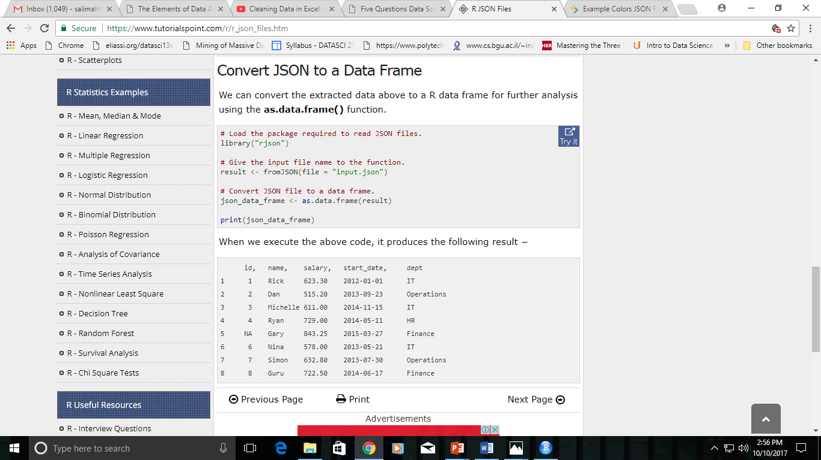
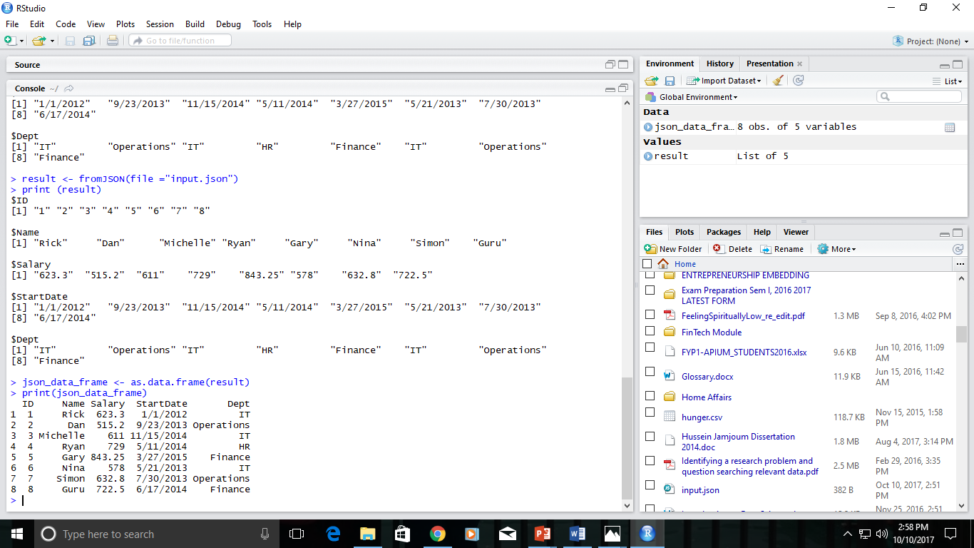
Convert JSON to a Data Frame
We can convert the extracted data above to a R data frame for further analysis using the as.data.frame() function.

Slide 5
Exercise - Geolocation
To see your own Geolocation data in JSON format, just open this link: http://ip-api.com/json/
Convert your geolocation data to a Data Frame.

Slide 6
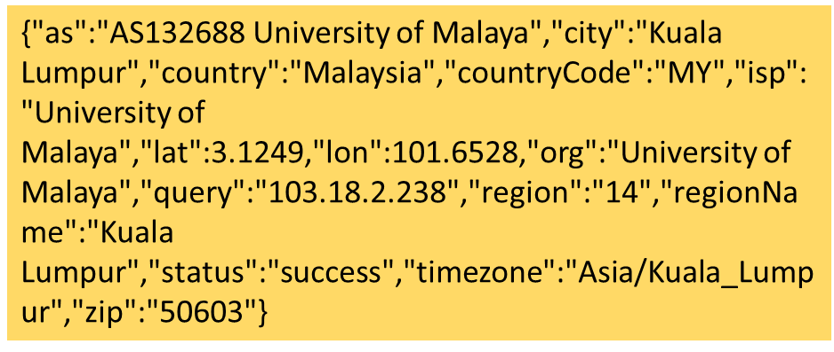
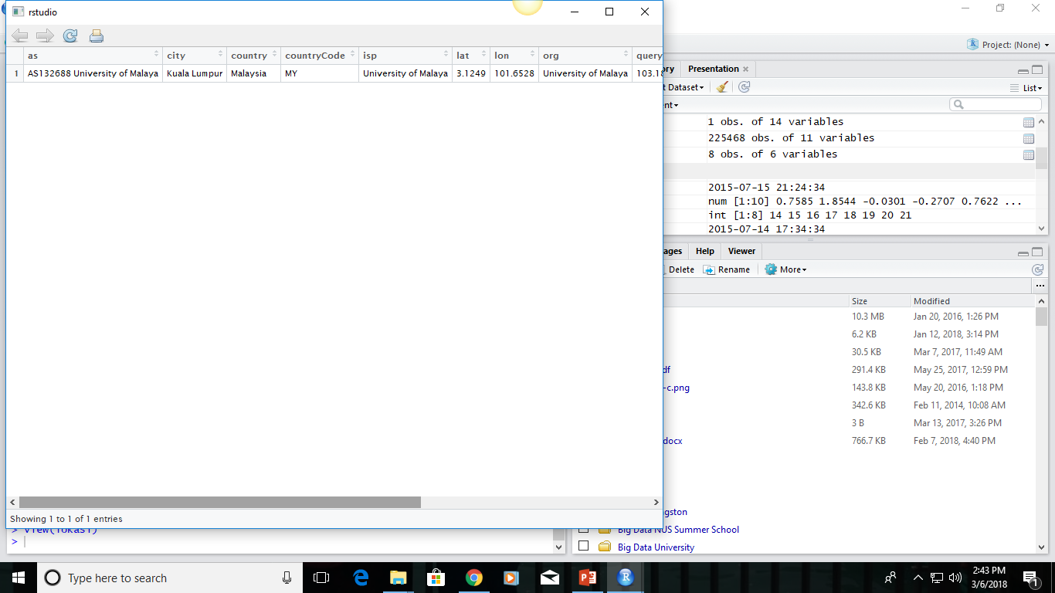
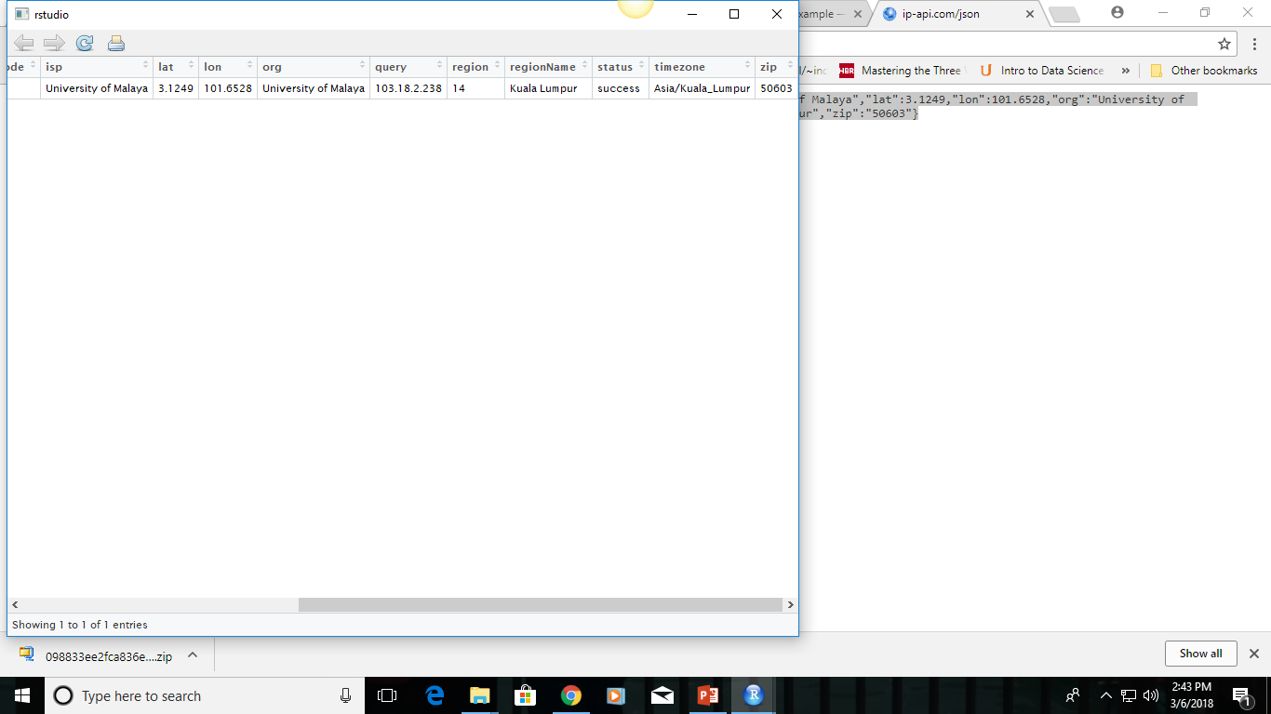
1 Observation , 14 Variables

Slide 7
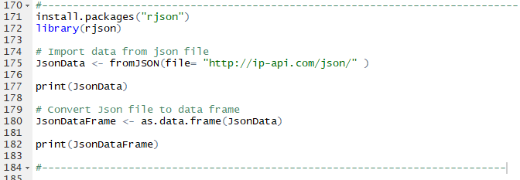
Solution to GeoLocation Exercise

Slide 8
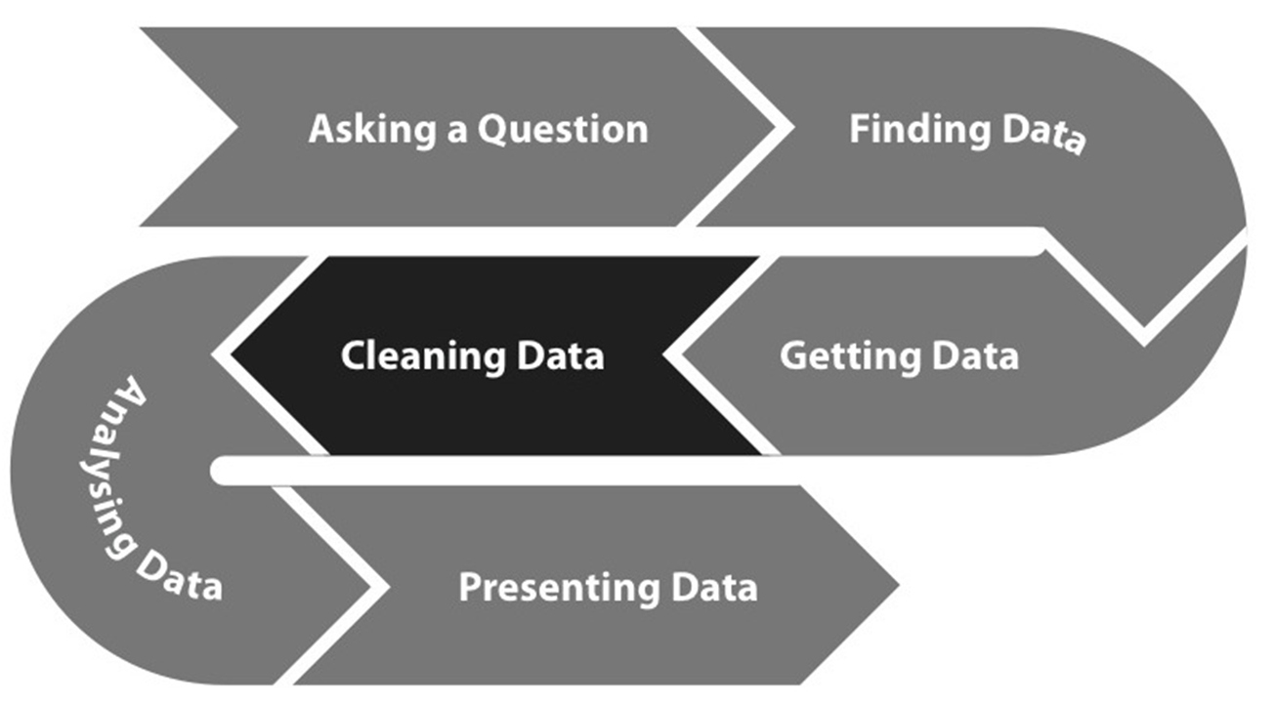
What Next?
Data cleaning is one those things that everyone does but no one really talks about.
The raw data
The strange binary file from a measurement machine
The unformatted Excel file with 10 worksheets the company you contracted with sent you
The complicated JSON data you got from scraping the Twitter API
The hand-entered numbers you collected looking through a microscope
You know the raw data is in the right format if you
Ran no software on the data
Did not manipulate any of the numbers in the data
You did not remove any data from the data set
You did not summarize the data in any way.
Processed Data
???
Raw Data
Real world data
“Dirty data”
Untidy and poorly formatted
Processed Data
Data that is ready for analysis
Processing can include merging, subsetting, transforming etc.
There may be standards for processing
All processing steps should be recorded.

Slide 9


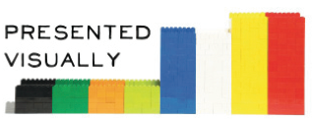
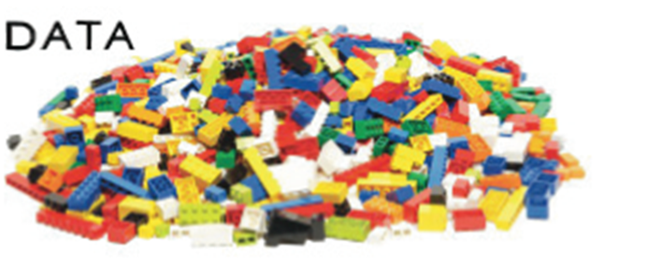
How can we make data less ugly for more beautiful insights?

Slide 10
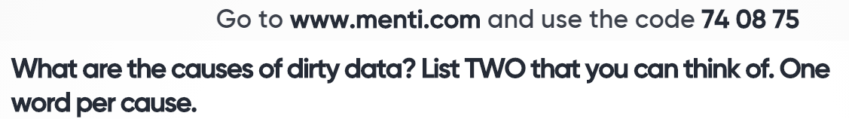

Slide 11
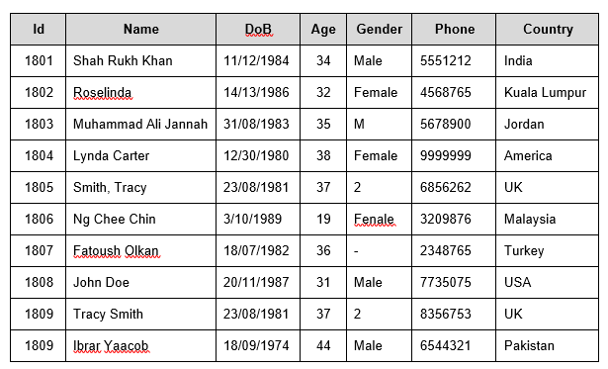
Is this An Acceptable Data Set?

Slide 12
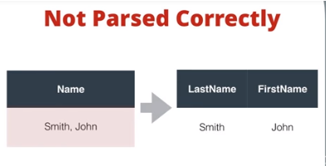
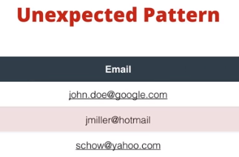
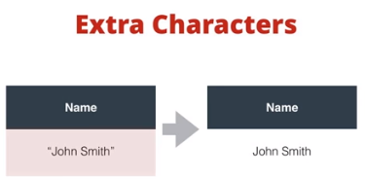
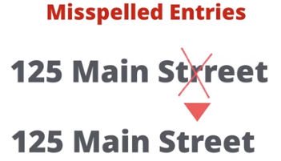
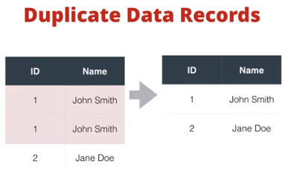
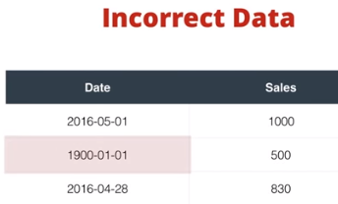
Dirty Data Problems
From Stanford Data Integration Course:
1) Parsing text into fields (separator issues)
2) Naming conventions: NYC vs New York
3) Missing required field (e.g. key field)
4) Different representations (2 vs Two)
5) Fields too long (get truncated)
6) Primary key violation (from un- to structured or during integration)
7) Redundant Records (exact match or other)
8) Formatting issues – especially dates
9) Licensing issues/Privacy/ keep you from using the data as you would like?

Slide 13
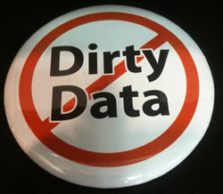
Common Types of Dirty Data
Incomplete data: most common occurrence of dirty data. Important fields on master data records, useful to the business, are often left blank. For example, if you haven’t classified your customers by industry, you cannot segment your sales and marketing initiatives by industry.
Duplicate data: very common. Most companies deal with issues with duplicate customer records, but duplicate materials are also very common. This can be costly to companies due to excess in inventory and sub-optimal procurement decisions.
Incorrect data: Incorrect data can occur when field values are created outside of the valid range of values. For example, the value in a month field should range from 1 to 12 or a street address should be a real address.
Inaccurate data: It is possible or data to be technically correct but inaccurate given the business context. Costly business interruptions are often rooted in inaccurate data. For example, minor errors in customer addresses can result in deliveries at the wrong locations even though the addresses are actual addresses.
Business rule violations: There are often large collections of poorly documented business rules associated with master data that are specific to the industry or business context. For example, beverage products should have a Unit of Measure in ‘fl. oz.’ or payment terms for a certain type of customers should always be ‘Net 30.’
Inconsistent data: Data redundancy–i.e., the same field values stored in different places-often leads to inconsistencies. For example, most companies have customer information in multiple systems and the data is often not kept in sync.

Slide 14
Where Does the “Dirt” Come From?
Dirty data caused by human error can take multiple forms:
Incorrect – The value entered does not comply with the field’s valid values. For example, the value entered for month is likely to be a number from 1 to 12. This value can be enforced with lookup tables or edit checks.
Inaccurate – The value entered is not accurate. Sometimes, the system can evaluate the data value for accuracy based on context. For most systems, accuracy validation requires a manual process.
Inconsistent – The value in one field is inconsistent with the value in a field that should have the same data. Particularly common with customer data, one source of data inconsistencies is manual or unchecked data redundancy.
In violation of business rules – The value is not valid or allowed, based on the business rules (e.g., An effective date must always come before an expiration date.)
Duplicate – The data appears more than once in a system of record. Common causes include repeat submissions, improper data joining or blending, and user error.
Incomplete – The data has missing values. No data value is stored in a field. For example, the street address is missing in a customer record.

Slide 15
Where Does the “Dirt” Come From?
Incomplete data comes from
N/A data value when collected
Different consideration between the time when the data was collected and when it is analyzed
Human/hardware/software problems
Noisy data comes from the processing of data
Collection
Entry
Transmission
Inconsistent data comes from
Different data sources
Functional dependency violation

Slide 16
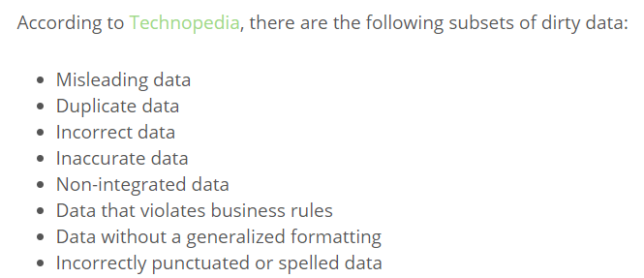

Slide 17
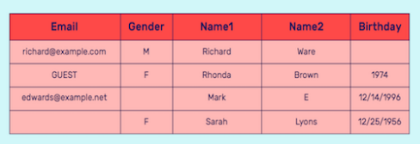
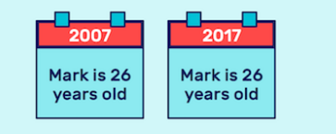
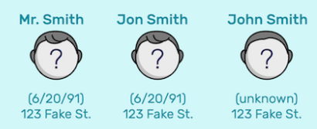

Identify these data problems

Slide 18
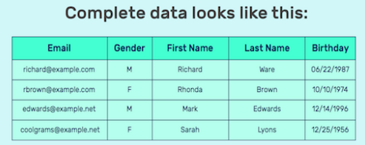
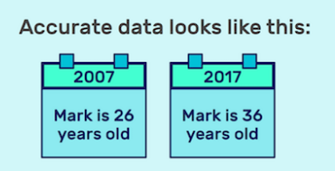
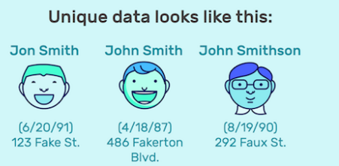
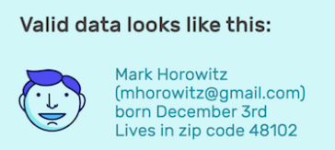

Slide 19
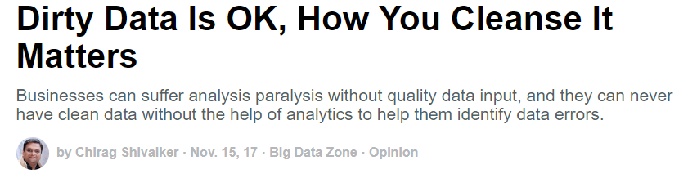
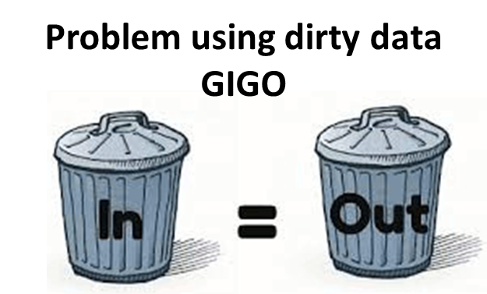
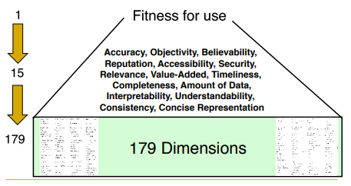
Why is Data Cleaning Important?
Cleaning and Transforming to get … High-quality data!
No quality data, no quality decisions!
What is Data of Good Quality?

Slide 20
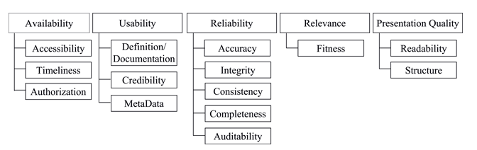
Data Quality Standard - composed of 5 dimensions of data quality
Availability is defined as the degree of convenience for users to obtain data and related information, which is divided into the three elements of accessibility, authorization, and timeliness.
Relevance is used to describe the degree of correlation between data content and users’ expectations or demands; adaptability is its quality element.
Usability means whether the data are useful and meet users’ needs, including data definition/documentation, reliability, and metadata.
Presentation quality refers to a valid description method for the data, which allows users to fully understand the data. Its dimensions are readability and structure.
Reliability refers to whether we can trust the data; this consists of accuracy, consistency, completeness, adequacy, and auditability elements.
https://datascience.codata.org/articles/10.5334/dsj-2015-002/

Slide 21
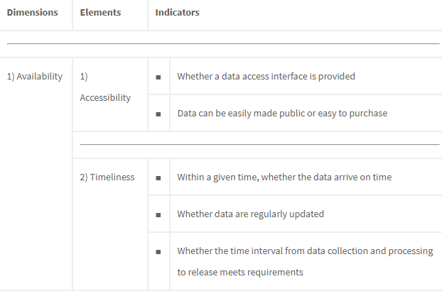
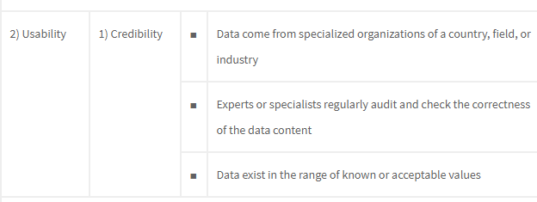

Slide 22
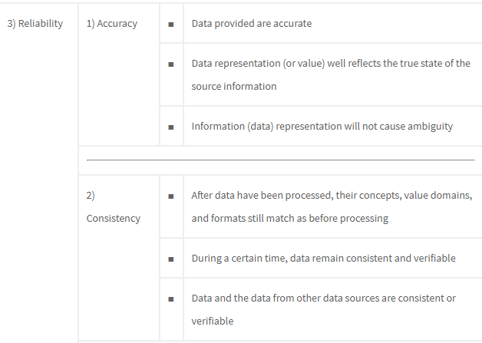
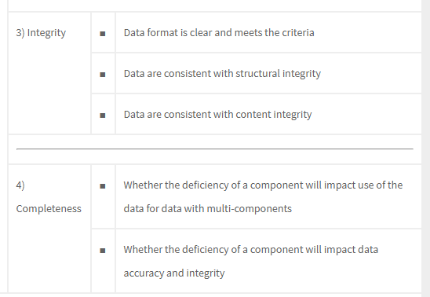

Slide 23
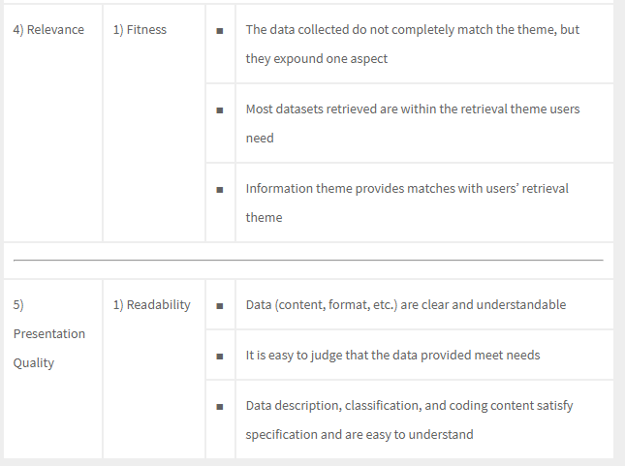

Slide 24
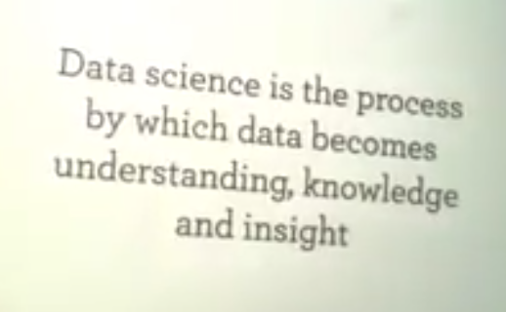
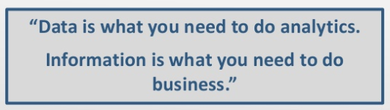

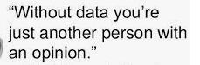
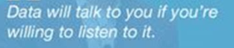
“Your results are only
as good as your data.”
“Torture the data, and it will confess to anything.”
“Errors using inadequate data are much less than those using no data at all.”

Slide 25
Tasks in Data Preparation / Data PreProcessing
Data cleaning - Fill in missing values, smooth noisy data, identify or remove outliers, and resolve inconsistencies
Data integration - Integration of multiple databases, data cubes, or files
Data transformation - Normalization and aggregation
Data reduction - Obtains reduced representation in volume but produces the same or similar analytical results

Slide 26
Data cleansing or data cleaning is the process of detecting and correcting (or removing) corrupt or inaccurate records from a record set, table, or database and refers to identifying incomplete, incorrect, inaccurate or irrelevant parts of the data and then replacing, modifying, or deleting the dirty or coarse data.
Data cleansing may be performed interactively with data wrangling tools, or as batch processing through scripting.
Wikipedia

Slide 27
Data Cleaning
Data cleaning is an important skill for data scientist.
“In our experience, the tasks of exploratory data mining and data cleaning constitute 80% of the effort that determines 80% of the value of the ultimate data.”
T. Dasu and T. Johnson
Authors of Exploratory Data Mining

Slide 28
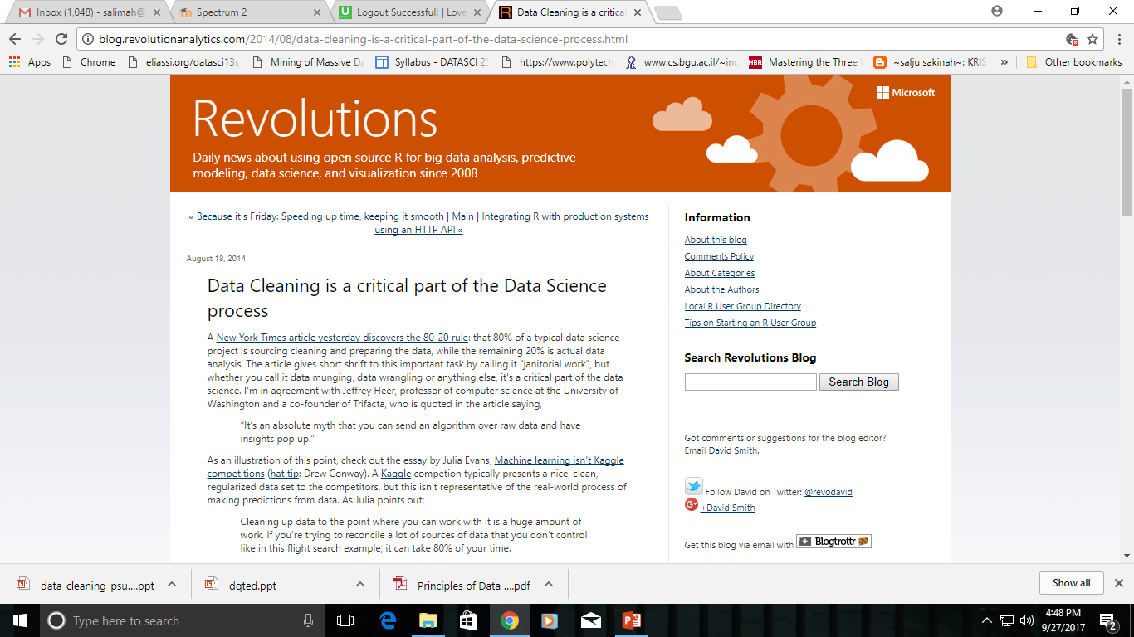
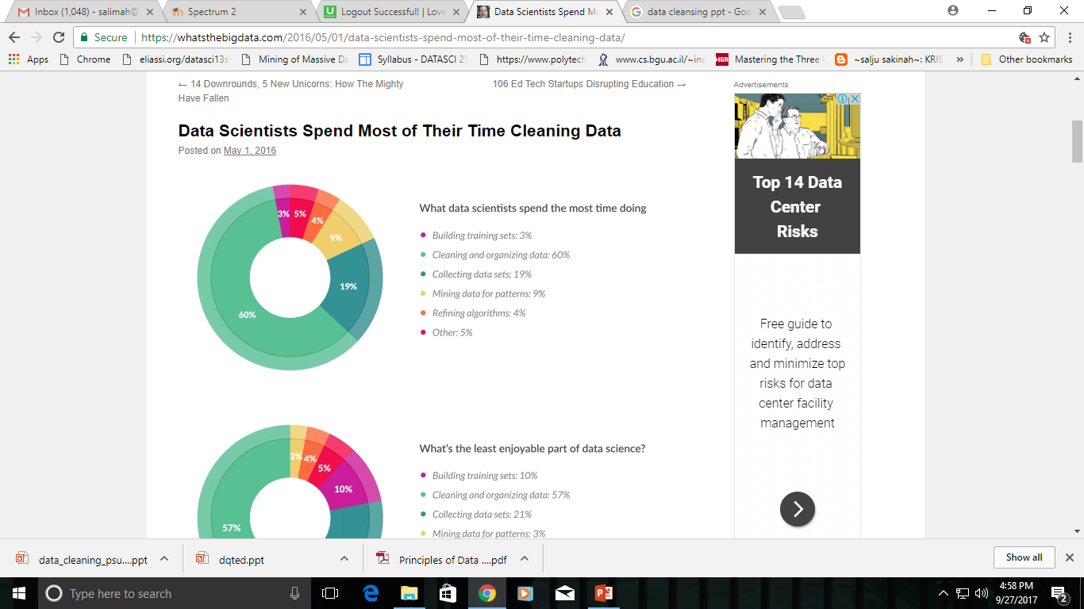
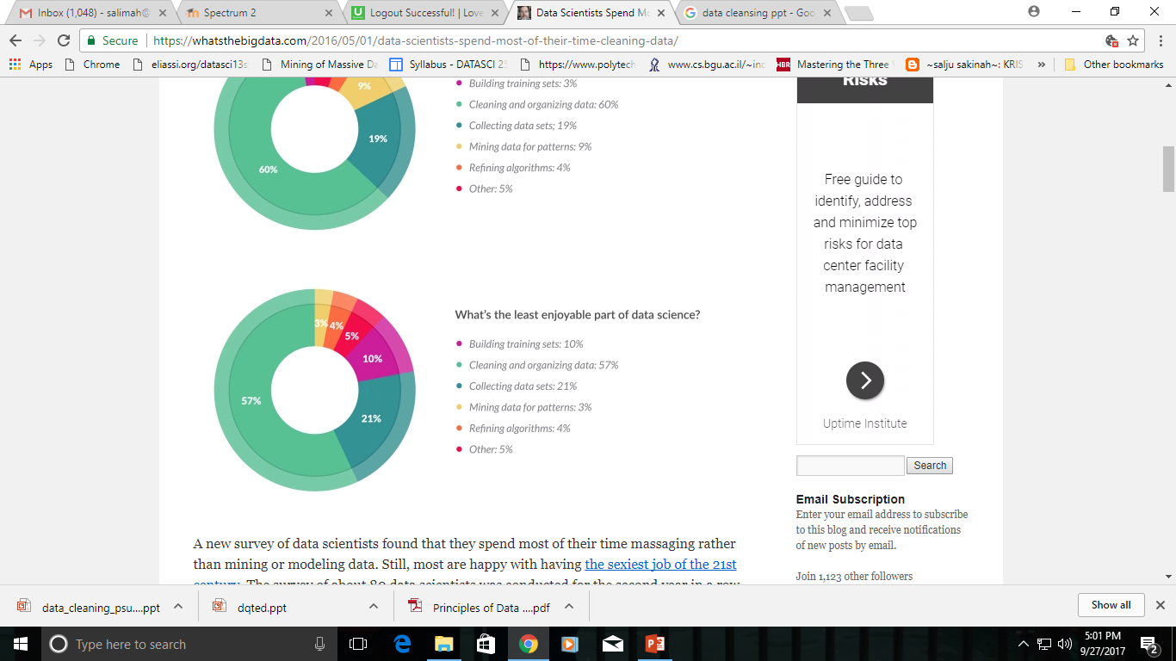
Data cleaning
80% of a typical data science project is sourcing cleaning and preparing the data, while the remaining 20% is actual data analysis.
Data cleansing
Data munging
Data wrangling

Slide 29
Cleaning Data
Fixing up formats – Often when data is saved or translated from one format to another, some data may not be translated correctly. E.g The timestamp_first_active column contained numbers like 20090609231247 instead of timestamps in the expected format: 2009-06-09 23:12:47. A typical job when it comes to cleaning data is correcting these types of issues.
Filling in missing values – Quite common for some values to be missing from datasets. This typically means that a piece of information was simply not collected. There are several options for handling missing data.
Correcting erroneous values – For some columns, there are values that can be identified as obviously incorrect. This may be a ‘gender’ column where someone has entered a number, or an ‘age’ column where someone has entered a value well over 100. These values either need to be corrected (if the correct value can be determined) or assumed to be missing.
Standardizing categories – More of a subcategory of ‘correcting erroneous values’, this type of data cleansing is so common it is worth special mention. In many (all?) cases where data is collected from users directly – particularly using free text fields – spelling mistakes, language differences or other factors will result in a given answer being provided in multiple ways. For example, when collecting data on country of birth, if users are not provided with a standardized list of countries, the data will inevitably contain multiple spellings of the same country (e.g. USA, United States, U.S. and so on). One of the main cleaning tasks often involves standardizing these values to ensure that there is only one version of each value.
Reference: http://www.kdnuggets.com/2016/03/doing-data-science-kaggle-walkthrough-cleaning-data.html

Slide 30
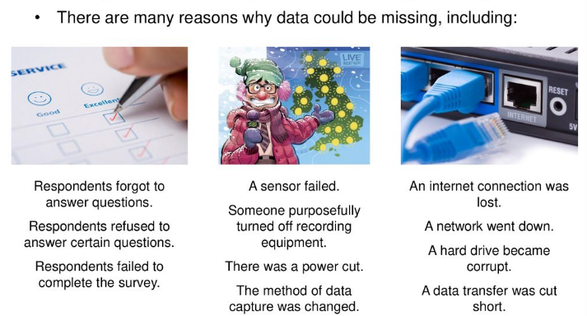
Missing Data

Slide 31
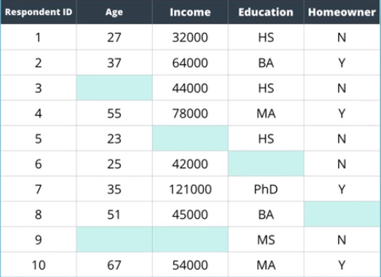
Missing Data
An issue of almost every raw data set!
What is Missing Data?
Missing data (or missing values) is defined as the data value that is not stored for a variable in the observation of interest.
Why Bother?
Some algorithm won’t work.
Can add BIAS to a model → overestimate or underestimate value

Slide 32
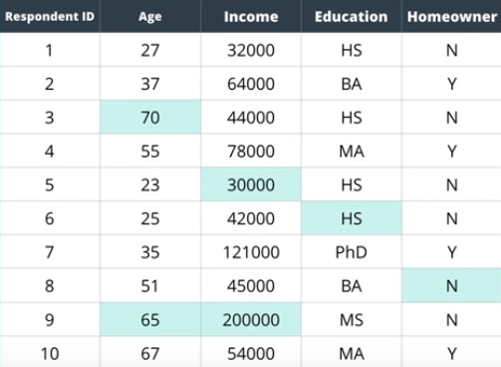
Real Data Set

Slide 33
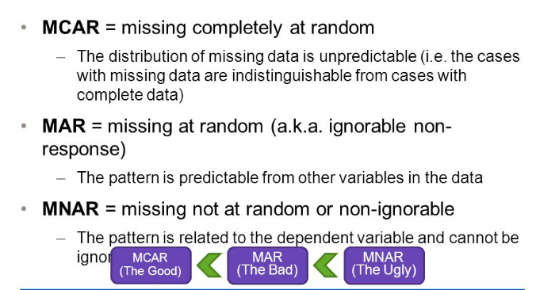
Pattern of Missing Data
There are 3 types of missing data:

Slide 34


Slide 35

Survey Data on Drug Abuse

Slide 36
Options for Dealing With Missing Data
Missing data in general is one of the trickier issues that is dealt with when cleaning data. Broadly there are TWO common solutions:
1. Deleting/Ignoring rows with missing values
The simplest solution - is to not use the records with missing values when training your model.
Some issues to be aware of before you starting deleting masses of rows from your dataset.
ONLY makes sense if the number of rows with missing data is relatively small compared to the dataset.
If deleting more than around 10% of your dataset due to rows having missing values, you may need to reconsider.
To delete the rows containing missing data, you have to be confident that the rows you are deleting do not contain information that is not contained in other rows.
2. Filling in the Values (Imputation)
Fill the missing values with a value. But what value to use? This depends on a range of factors, including the type of data you are trying to fill.
For categorical data (i.e. countries, device types, etc.) - make sense to simply create a new category that will represent ‘unknown’. Another option may be to fill the values with the most common value for that column (the mode).
For numerical values (for example the age column) - use the mean or median or average based on some other criteria.

Slide 37


Mode
The number that occurred the most often in the data set.

Slide 38


Deleting rows with missing values

Slide 39

Imputed Data (Mean)
Simple imputation methods have been used and may be sufficient in some settings, but have potential to introduce bias and inaccuracy into the statistical analysis.
More complex methods such as multiple imputation potentially offer reduced risk of bias.

Slide 40

The Effect
Missing data can also lead to misleading results by introducing bias

Slide 41

https://towardsdatascience.com/how-to-handle-missing-data-8646b18db0d4

Slide 42



Slide 43


Argument
Dropping observations that have missing values.
Imputing the missing values based on other observations.
Dropping missing values is sub-optimal because when you drop observations, you drop information.
The fact that the value was missing may be informative in itself.
“Missingness" is almost always informative in itself, and we should tell your algorithm if a value was missing.
Missing data puzzle pieces
Missing data is like missing a puzzle piece.
If you drop it, that’s like pretending the puzzle slot isn’t there.
If you impute it, that’s like trying to squeeze in a piece from somewhere else in the puzzle.
Always tell the algorithm that a value was missing because missingness is informative.

Slide 44
Suggestion
Label as missing.
The key is to tell your algorithm that the value was originally missing.
Missing categorical data
The best way to handle missing data for categorical features is to simply label them as ’Missing’!
We’re essentially adding a new class for the feature.
This tells the algorithm that the value was missing.
Missing numeric data
For missing numeric data, you should flag and fill the values.
Flag the observation with an indicator variable of missingness.
Then, fill the original missing value with 0 just to meet the technical requirement of no missing values.
By using this technique of flagging and filling, we are essentially allowing the algorithm to estimate the optimal constant for missingness, instead of just filling it in with the mean.

Slide 45
Tools of Data Preprocessing
R - R a framework that consists of various packages that can be used for Data Preprocessing like dplyr etc
Weka - Weka is a software that contains a collection of Machine Learning algorithms for Data Mining process. It consists of Data Preprocessing tools that are used before applying Machine Learning algorithms.
RapidMiner - RapidMiner is an open-source Predictive Analytics Platform for Data Mining process. It provides the efficient tools for performing exact Data Preprocessing process.
Python - Python is a programming language that provides various libraries that are used for Data Preprocessing.

Slide 46

Handling Missing Data in R
In R, missing values are represented by the symbol NA (not available).
Impossible values (e.g., dividing by zero) are represented by the symbol NaN (not a number).
Check for missing data in a data set
When inputting data directly into R, 'NA' is used to designate missing data. For example,
> xvar <- c(2,NA,3,4,5,8)
Creates a variable ('xvar') for a sample of 6 subjects, but the second subject is missing data for this variable. NA is also used to indicate missing data when R prints data:
> xvar
[1] 2 NA 3 4 5 8
> is.na(xvar)
[1] FALSE TRUE FALSE FALSE FALSE FALSE
Swirl

Slide 47
Data Manipulations
Filtering, or subsetting: Remove observations based on some condition.
Aggregating: collapse multiple values into a single value (e.g., count, average, summing or taking means).
Transforming: add new variables or modify existing variables (e.g., log-transforming).
Sorting: change the order of values.
Data
Reduction

Slide 48


Tidy Data
The end goal of cleaning data process.
Each variable should be in one column.
Each observation of that variable should be in a different row
There should be one table for each kind of variable
– if there are multiple tables, there should be a column to link them
Include a row at the top of each file with variable names (variable names should make sense, human readable)
In general data should be save in one file per table.
The point of creating a tidy data set is to get the data into a format that can be easily shared, computed on, and analyzed.
Variables = Columns
Observations = Rows
Data set = Table

Slide 49
Code Book
For almost any data set, the measurements you calculate will need to be described in more detail than you will sneak into the spreadsheet.
It is the meta data.
At minimum a code book should contain:
Information about the variables (including units!) in the data set not contained in the tidy data.
Information about the summary choices you made.
Information about the experimental study design you used.

Slide 50
Data Cleaning Hands-on Examples
Tricks for cleaning your data in R
https://github.com/underthecurve/r-data-cleaning-tricks/blob/master/R-datacleaning-tricks.md
Essential data cleaning for ad-hoc tasks in R
https://datascienceplus.com/essential-data-cleaning-for-ad-hoc-tasks-in-r/
Checklist for Data Cleansing
https://sebastiansauer.github.io/data_cleansing/

Slide 51
References
The Elements of Data Analytic Style http://worldpece.org/sites/default/files/datastyle.pdf
See Cleaning Data in Excel - https://www.youtube.com/watch?v=pIyMc-oqbv4
A Taxonomy of Dirty Data - https://www.researchgate.net/publication/220451798_A_Taxonomy_of_Dirty_Data
Natural Language Processing (Part 2): Data Cleaning & Text Pre-Processing in Python https://www.youtube.com/watch?v=iQ1bfDMCv_c

